Slide 1
System development life cycle
CT026-3-1-Systems Analysis and Design

Slide 2
Topic Learning Outcomes
At the end of this topic, you should be able to:
1. Explain each of the SDLC phases briefly
2. Define Systems Development Methodology
3. Explain the importance of Systems Development Methodology

Slide 3
Contents & Structure
Overview of SDLC
Phases in SDLC

Slide 4
Key terms you must be able to use
If you have mastered this topic, you should be able to use the following terms correctly in your assignments and exams:
SDLC

Slide 5
Recap From Last Lesson
Identify FOUR (4) skills that a system analyst should have.
1. Analytical Skills
2. Management Skills
3. Technical Skills
4. Interpersonal Skills

Slide 6
Introduction to SDLC
System development life cycle - an attempt to establish structured approach to systems analysis and design
Structured Analysis
Structured analysis uses a concept called the system development life cycle (SDLC)
to plan and manage the system development process.
The SDLC describes activities and functions that all system developers perform

Slide 7
Systems Development Life Cycle
Also known as applications development cycle
an organized approach used in organizations to develop an information system
a traditional methodology
normally used on large projects
require extensive development periods more than 1 year
complicated
results do not always satisfy the user
an expensive approach considering the money, time and effort put in

Slide 8
Overview of SDLC phases
The SDLC model usually includes five steps
System planning
System analysis
System design
System implementation
System security and support

Slide 9

Overview of SDLC phases
Common understanding of phases and activities involved in each phase
Milestones

Slide 10
Phases in SDLC
Systems Planning
Begins the process with system request which describes problems or desired changes in an IS or a business process
Purpose of this phase is to perform a preliminary investigation to evaluate an IT related business opportunity and problem
Preliminary investigation is a critical step because the outcome will affect the entire development process
Deliverable is preliminary investigation report

Slide 11
Phases in SDLC
Systems Analysis
The purpose is to build a logical model of the new system
By creating requirement modelling which to investigating business processes and document new system
Perform fact-finding techniques such as interview, survey
Deliverable is the system requirements document

Slide 12
Phases in SDLC
Systems Design
Create a physical model that satisfies all documented requirements for the system
Design user interface
Identify outputs, inputs, and processes
Deliverable is the system design specification
Management and user involvement is critical

Slide 13
Phases in SDLC
Systems Implementation
New system is constructed
Programs are written, tested and documented
System is installed
Deliverable is a completely functioning and documented information system

Slide 14
Phases in SDLC
Systems Security and Support
A well-designed system must be secure, reliable, maintainable, and scalable
Maintenance changes correct errors and adapt to changes in the environments, such as new tax rates.
Enhancements provide new features and benefits the objective during this phase is to maximize return on the IT investment.
Security controls safeguard the system from both external and internal threats.
A scalable design can expand to meet new business requirements and volumes.
Most information systems need to be updated significantly or replaced after several years of operation.

Slide 15
Systems Development Methodology
Definition
A standard process followed in an organization to conduct all the steps necessary to analyze, design, implement & maintain IS.

Slide 16
Systems Development Methodology
Importance
To ensure consistency in management of projects
To ensure easier estimation of project times and costs
To eliminate those causes of unsuccessful system development – e.g. a more understandable process
Reduce time & cost
Interact & encourage user involvement
To improve the quality of work & system
Produce complete & accurate design specification and documentation
Meet user requirement

Slide 17
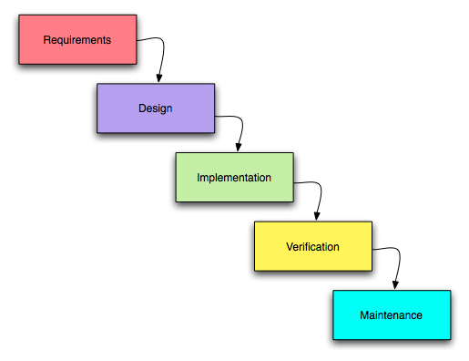
Waterfall Methodology
Various Methods to implement SDLC
Waterfall Methodology ≠ SDLC

Slide 18

Waterfall Methodology
Main problem is the inflexible division of a project into separate stages.
Commitments made earlier on and it is difficult to react to changes in requirements
Unsuitable if requirements are not well understood or likely to change

Slide 19
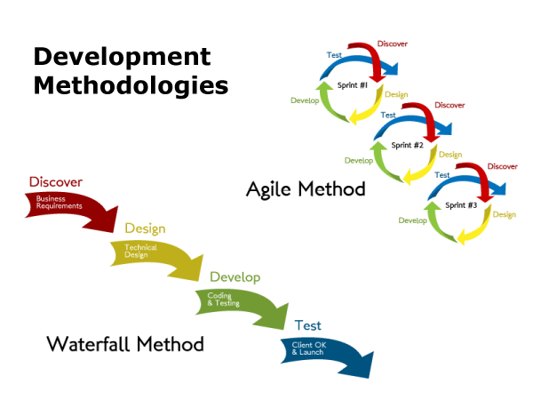

Slide 20
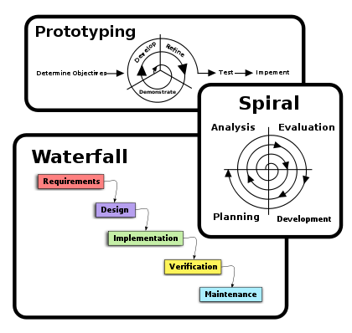

Slide 21
Summary
Overview of SDLC (Systems Development Life Cycle)
Overview of phases in SDLC
Systems development methodology

Slide 22
What To Expect Next Week
In Class
Preparation for Class
Planning
Problem Statement
System Change Request
Preliminary Investigation
Download the slide and study for the next chapter.

